Slide 1
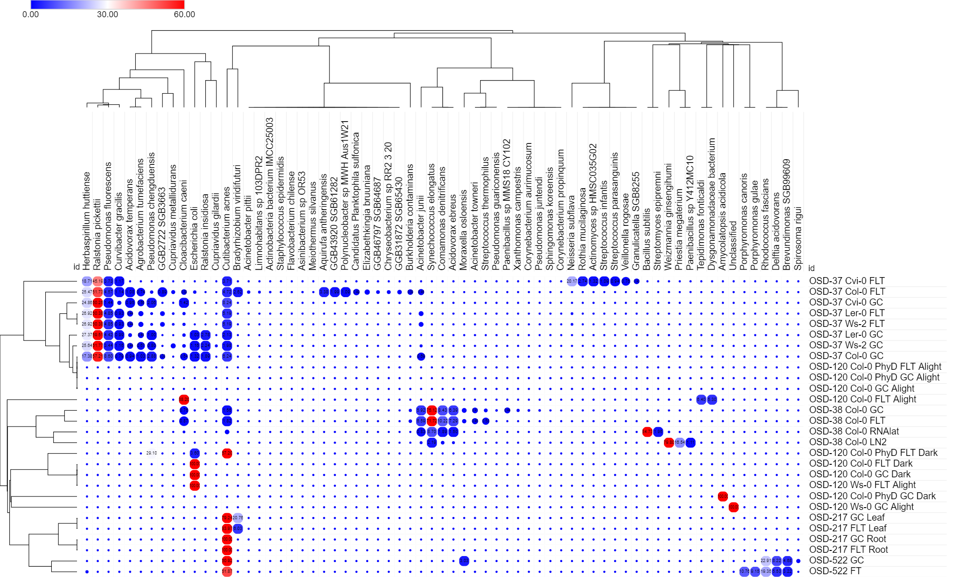
Summary heat map of microbes

Slide 2
Summary stacked bar chart map of microbes

Slide 3
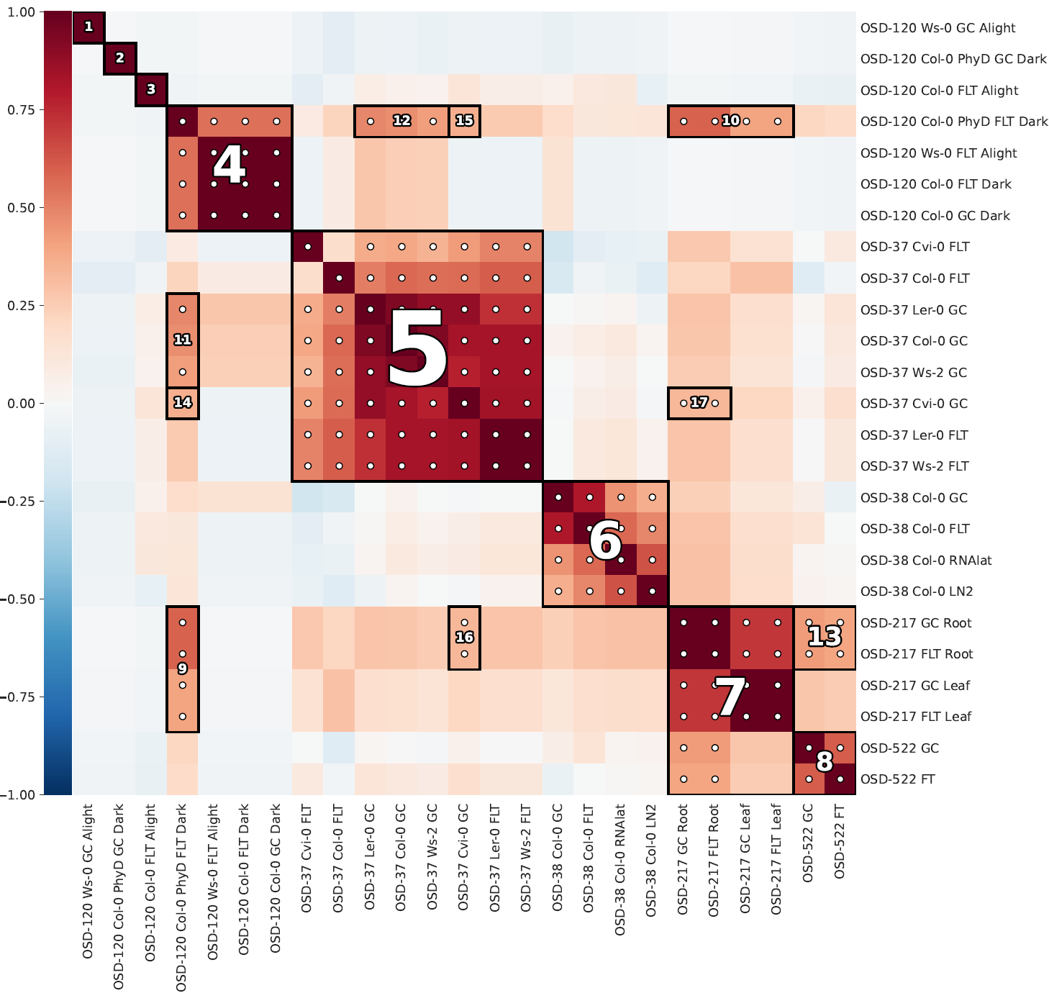
Summary HAIIA (Hierarchical All-Against-All Association) analysis

